Slide 1

React Redux Complete Tutorial

Slide 2
Usually, How to pass data in React JS?
App.js
C1
C5
C7
C2
C6
The data in React always flows from parent to child components which makes it Unidirectional
C3
C4
DATA
Note: We can’t Send Data from C4 to C1,C5
Notes:
Difference btw Redux and Flux.
Flux differentiates between the dispatcher and store, this is because Flux supports multiple stores
Redux limits the application to one store which means the store and dispatcher can be combined into one dispatcher-store

Slide 3
In React Hooks (Context API, useContext)
Without Context
With Context
Provider
App.js
App.js
Data
Employee
Employee
Consumer
Employee Info
Employee
Info
Notes:
Difference btw Redux and Flux.
Flux differentiates between the dispatcher and store, this is because Flux supports multiple stores
Redux limits the application to one store which means the store and dispatcher can be combined into one dispatcher-store

Slide 4
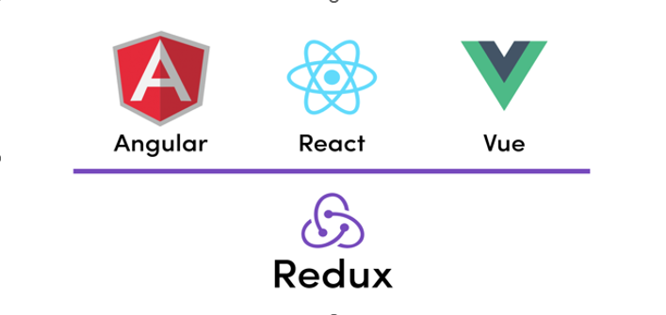
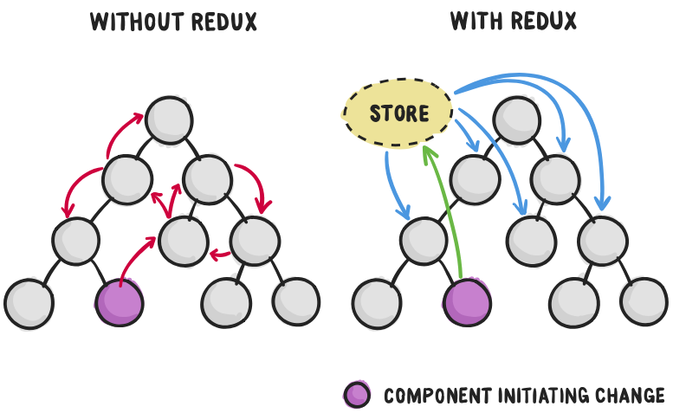

What is Redux?
It is state management library.
Redux is inspired by Flux.
Centralize the application state.
Single source truth.
Make Data flow transparent and predictable.
Components don’t maintain their own states.
Synchronizing the data across application.
Notes:
Difference btw Redux and Flux.
Flux differentiates between the dispatcher and store, this is because Flux supports multiple stores
Redux limits the application to one store which means the store and dispatcher can be combined into one dispatcher-store

Slide 5
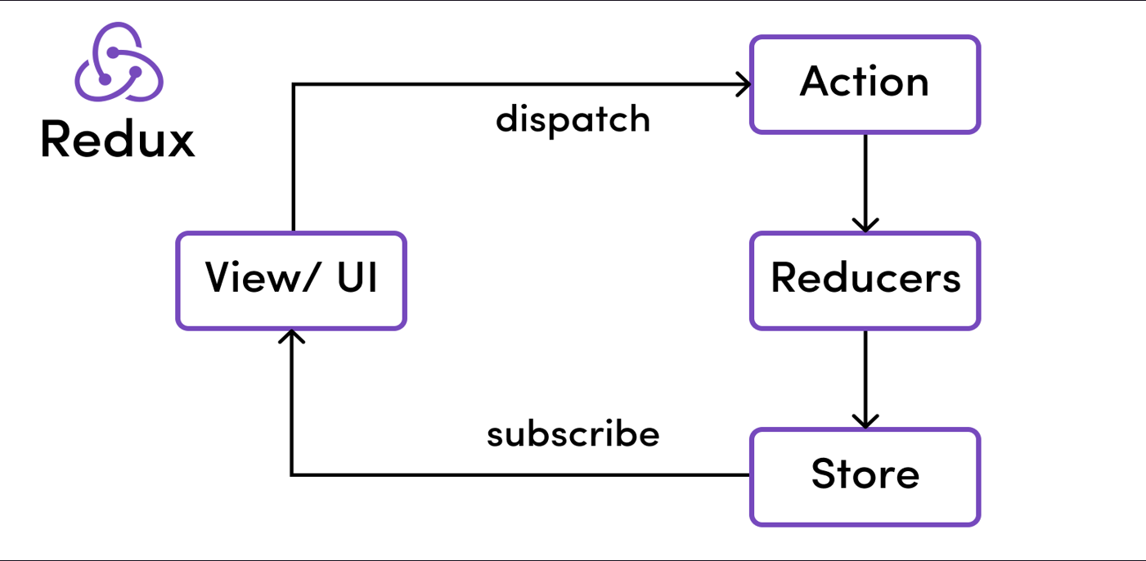
Core Principles of Redux
Overview

Slide 6
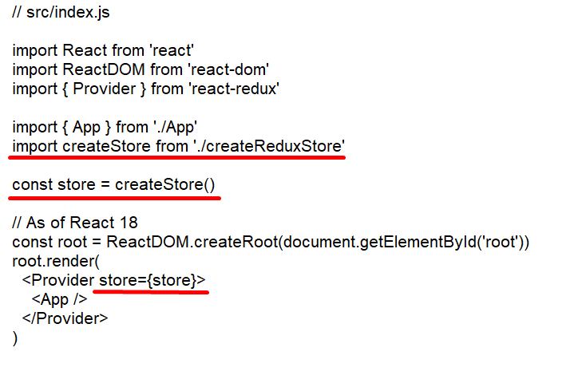
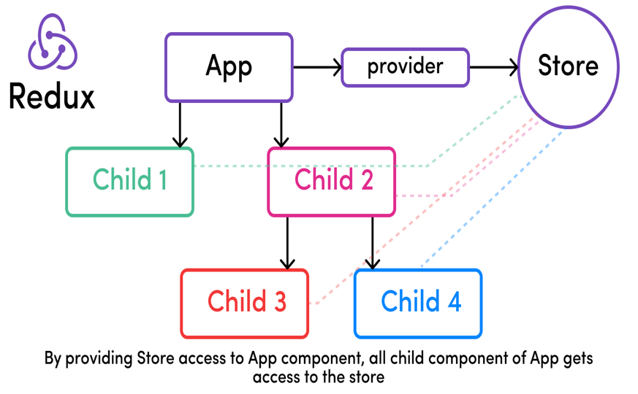
Redux Store
The global state of an application is stored in an object tree within a single store.
The Redux store is the main, central bucket which stores all the states of an application.

Slide 7
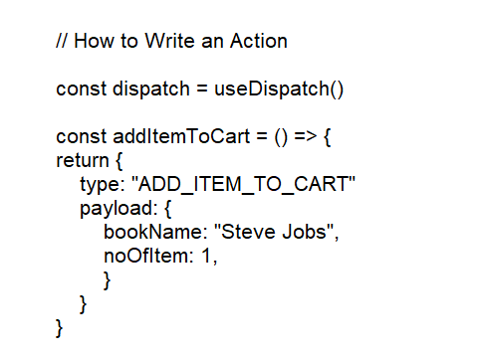
Redux Actions
State in Redux is read-only, reducer returns a new state - no callbacks modifying state in place.
If anyone wants to change the state of the application, then they'll need to express their intention of doing so by emitting or dispatching an action.

Slide 8
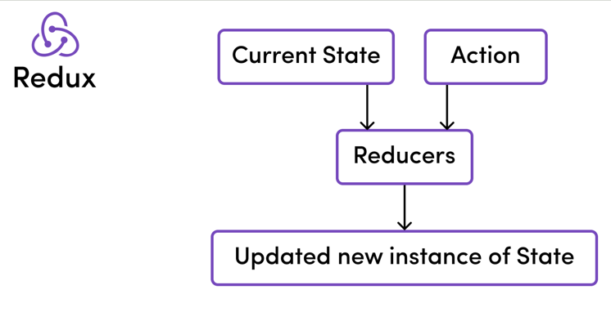
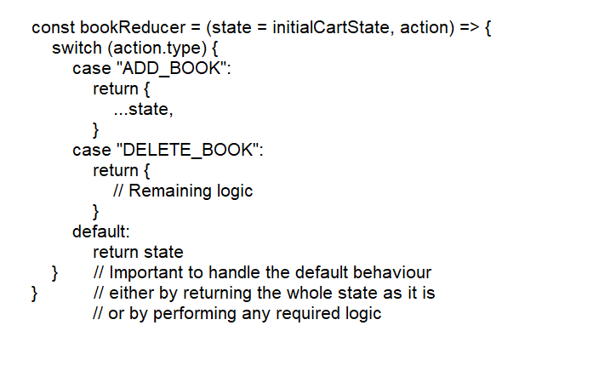
Redux Reducers
Reducers, as the name suggests, take in two things: previous state and an action. Then they reduce it (read it return) to one entity: the new updated instance of state.
There can either be one reducer if it is a simple app or multiple reducers taking care of different parts or slices of the global state in a bigger application.

Slide 9
Core Principles - Conclusion
In short, the following three principles completely govern how Redux works:
The global state of an application is stored in an object tree within a single store
The only way to change the state is to emit an action, which is an object describing what happened.
To specify how the state tree is transformed by actions, we write pure reducers

